Slide 1
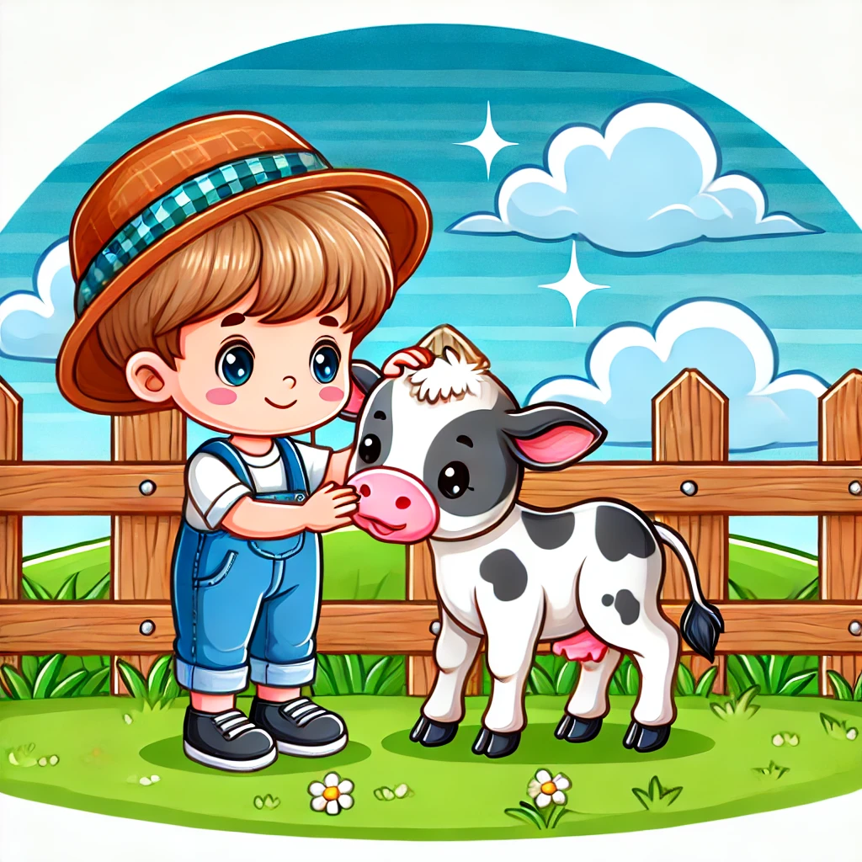
Taf had a calf.
The calf was soft.

Slide 2

Def had a chef hat.
He made a beef dish.

Slide 3

Tif had a gift.
It was big!

Slide 4
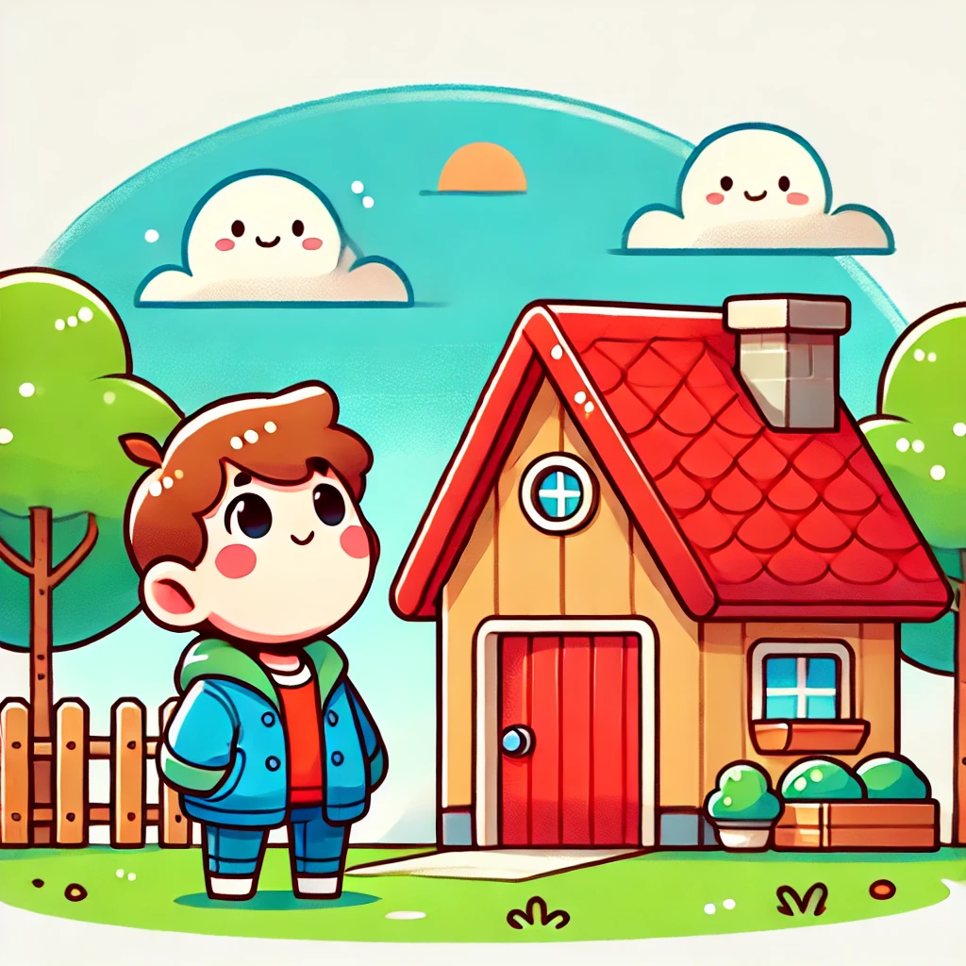
Ofi saw a roof. It was red.

Slide 5
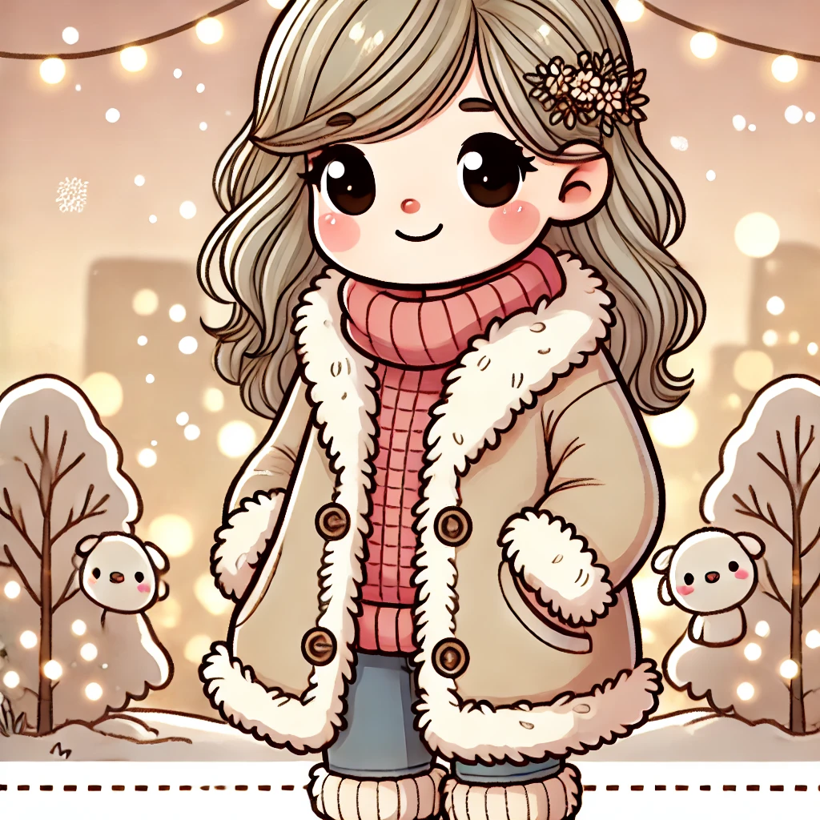
Luf had fluff on her coat.
It was warm!

